Slide 1
Accommodation and Compliance webcast Series Supports and Services: Accommodations with a Heartbeat
James Potts, Senior Consultant, Cognitive/Neurological
Lisa Mathess, Lead Consultant, ADA Specialist
Tracie DeFreitas, Director of Training, Services, and Outreach

Slide 2
Housekeeping
2
Technical Difficulties
Q&A option at the bottom of the screen
800-526-7234 or 877-781-9403 (TTY) OR Live Chat at AskJAN.org
Frequently Asked Questions (FAQ) AskJAN.org/Training/JAN-Webcast-Frequently-Asked-Questions.cfm
Questions for Presenters
Q&A option at the bottom of the screen

Slide 3
Housekeeping 2
3
PPT Slides
Click the link included in the webcast login email you received, see the link in the chat, or go to this webcast event from the Training page at AskJAN.org
Captioning
Use the closed caption (CC) option or captioning link in the chat

Slide 4
Accommodations with a Heartbeat Talking Points
Service and Emotional Support Animals
Job Coaches, Support Persons, Mentors
Personal Attendant Services (PAS)
Sign Language Interpreters
Q&A

Slide 5
Heartbeat accommodation Service Animals

Slide 6
Service animals
Help with:
Retrieving objects
Mobility and navigation
Detecting sounds
Medical maintenance

Slide 7
Service Animals — Common Issues
Access rights under title I of the Americans with Disabilities Act (ADA)
Supporting the accommodation with medical information
Service animal training and certification
Coworker interaction and communication

Slide 8
What Animals qualify as a service animal?

Slide 9
Use the Q&A Option to Submit

Slide 10
Heartbeat Accommodation Emotional Support Animals

Slide 11
Emotional Support Animals
Help by:
Providing comfort and companionship
Easing anxiety, depression, and phobias
Relieving emotional stress
Facilitating mindfulness

Slide 12
Emotional Support Animals — Common Issues
Access rights under the ADA; title I versus titles II and III
Remembering what an accommodation is, looking at the disability need and the appropriateness of an animal in the workplace
Setting expectations for workplace behavior

Slide 13
Can emotional support animals Be Denied at Work?

Slide 14
Situation: Emotional Support Animal
An employee with Post Traumatic Stress Disorder (PTSD) had to periodically inspect landfills but going to the landfills triggered PTSD symptoms. The employee asked to be allowed to take her emotional support dog to the landfills. The employer was concerned about granting the request because the dog was not a trained service dog.

Slide 15
Use the Q&A Option to Submit (1)

Slide 16
Heartbeat Accommodation Personal Assistants: Job Coach Support Person Mentor

Slide 17
Job coach
Helps employee learn a job
Provides intensive monitoring, training, assessment, and support
Helps develop healthy working relationships
Assists in determining accommodations

Slide 18
Job Coach — Common issues
Who determines the appropriate job coach?
How long will the job coach be needed?
What about situations involving confidentiality?

Slide 19
WHO IS ACTUALLY PERFORMING THE JOB?

Slide 20
Situation: Job Coach
A newly hired school janitor with an intellectual disability was having trouble learning the job and staying on task. The employee was easily distracted and liked to talk to the students when he was supposed to be working.

Slide 21
Support person
Helps take notes
Provides comfort and encouragement
Eases apprehension
Provides moral support
Provides explanations and aids comprehension

Slide 22
Support Person — Common Issues
Mama bear instincts
Support person taking over the meeting
Who picks the support person?
Only there to meet disability-related need of the employee

Slide 23
mentor
Should be experienced and trusted
Aids in relationship building
Helps understand workplace culture and policy
Helps consider accommodation options

Slide 24
Mentor — Common Issues
Who selects the mentor?
What will the mentor do?
How to make sure a mentor is effective

Slide 25
Use the Q&A Option to Submit (2)

Slide 26
Heartbeat Accommodation Personal Attendant Services (PAS)

Slide 27
Personal attendant services
Help with:
Activities of daily living
Toileting
Eating
Grooming

Slide 28
Personal attendant services — Common Issues
Is PAS required as a job accommodation under the ADA?
What about under the Rehab Act?
Liability

Slide 29
Situation: Personal Attendant SERVICES
A lead surveyor/researcher had to travel periodically for work. They had Parkinson’s disease, which had progressed to the point that the employee needed a personal attendant. Their spouse ordinally served as the individual’s personal attendant but could not afford to travel with the employee as much as needed.

Slide 30
WHO PAYS AND WHO PICKS?

Slide 31
Use the Q&A Option to Submit (3)

Slide 32
Heartbeat Accommodation Sign Language Interpreter

Slide 33
Sign Language interpreter
Helps with:
Communication
Interaction
Common issues:
Who is responsible for providing the interpreter?
How far do we have to go?

Slide 34
Who is responsible for providing the interpreter?

Slide 35
Situation: Interpreter
A government agency contracted with a private company to provide training for agency employees. An employee who is deaf needed to attend the training, so the employer contacted the company about providing an interpreter. The company indicated that the government agency would have to provide the interpreter even though the contract specified that the private company would provide accommodations.

Slide 36
situation: Interpreter (2)
A person who was deaf was hired to work in an office setting. The employer hired an interpreter during the employee’s initial training and for meetings, but the employee indicated they would also like to be able to communicate with co-workers socially and asked that the interpreter be provided full time.

Slide 37
How far does an Employer have to go?

Slide 38
Use the Q&A Option to Submit (4)

Slide 39
Contact JAN
Visit
AskJAN.org
Call
800.526.7234
877.781.9403 (TTY)
Chat
@ AskJAN.org
Submit
JAN on Demand Inquiry @ AskJAN.org/JANonDemand.cfm
Email
JAN@AskJAN.org
Social Media
Facebook – Job Accommodation Network Twitter – @JANatJAN

Slide 40
Thank you for attending Supports and Services: Accommodations with a Heartbeat!
Next JAN Webcast: “What You Should Know About the Impact of Long COVID in the Workplace”
JAN Training Events & Resources AskJAN.org/Events/Trainings.cfm

Slide 41
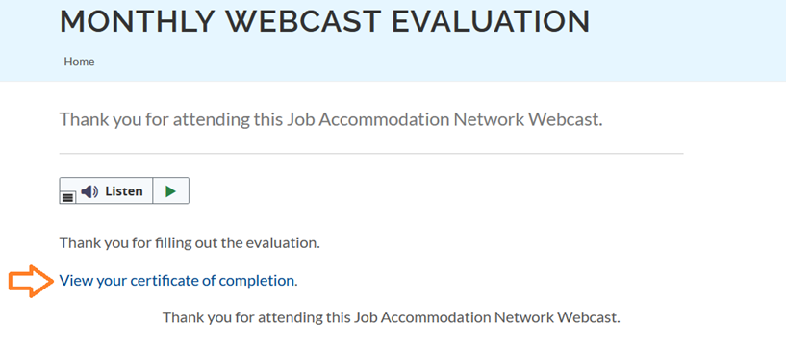
How do I claim the HR CEU?
Don’t close the JAN webcast browser
Complete the webcast evaluation in new window
Click on “View your certificate of completion.”
Or go to AskJAN.org/EvaluationReg.cfm

