Slide 1
What You Should Know About the Impact of Long COVID in the Workplace A collaborative Presentation: DMEC, Sedgwick, EARN, And JAN

Slide 2
Collaborating Speakers
Terri Rhodes, Chief Executive Officer, Disability Management Employer Coalition (DMEC)
Bryon Bass, Senior Vice President, Workforce Absence & Disability Practice Leader, Sedgwick
Susanne Bruyere, Co-Director & Co-Principal Director, Employer Assistance & Resource Network on Disability Inclusion (EARN)
Tracie DeFreitas, Director of Training, Services & Outreach, JAN

Slide 3
Housekeeping
Technical Difficulties
Q&A option at the bottom of the screen
800-526-7234 or 877-781-9403 (TTY) or Live Chat at AskJAN.org
Frequently Asked Questions (FAQ) AskJAN.org/Training/JAN-Webcast-Frequently-Asked-Questions.cfm
Questions for Presenters
Q&A option at the bottom of the screen

Slide 4
Housekeeping 2
PPT Slides
Link to PPT is included in webcast login email, or see the link now in the chat, or go to this webcast event from the Training page at AskJAN.org
Captioning
Use the closed caption (CC) option or captioning link in the chat

Slide 5
What You Should Know About the Impact of Long COVID in the Workplace
Discussion Points
DMEC Long COVID Think Tank Findings
Long COVID Roundtable and EARN Resources
Accommodation Process Tips
Accommodation Solutions—Time Permitting

Slide 6
DMEC Think Tank Findings Terri Rhodes, DMEC Bryon Bass, Sedgwick

Slide 7
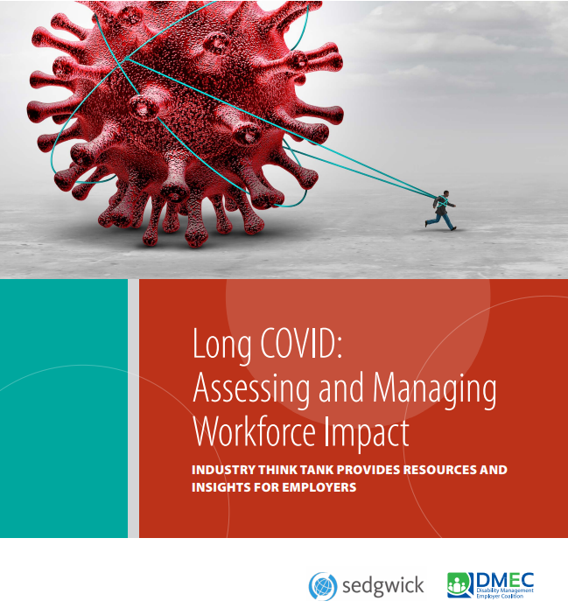
Long COVID: Assessing and Managing Workforce Impact
http://dmec.org/2023/01/18/long-covid-assessing-and-managing-workforce-impact/

Slide 8
Global Impact ON HEALTH, PRODUCTIVITY, THE BOTTOM LINE
Long COVID is the next global health concern
As recession fears loom, long COVID is a direct threat to cost containment and productivity

Slide 9
INADEQUACIES in Healthcare
Long COVID highlights inadequacies in the healthcare and disability system that require broad collaboration across sectors to address

Slide 10
Exacerbates MENTAL HEALTH CRISIS
Long COVID exacerbates an already overwhelming mental health crisis

Slide 11
SUPPORTING EMPLOYEES
Long COVID is requiring employers to adapt an accommodation-friendly culture and find creative solutions
Long COVID highlights the gap between employers that have formal stay-at-work and return-to-work programs and those that don’t

Slide 12
Recommendations
Provide Reasonable Accommodations
Job restructuring, modified work schedules, and reassignment to open positions
Focus on the limitations of the impairment(s), and tailor accommodations to address each
Educate Employees
Mental health and wellness information is more important than ever
Enhance Access to Care
Promote and highlight all services and resources available
Eliminate Stigma
Create a safe and open environment for workers to comfortably address these issues

Slide 13
Summary
COVID-19 has claimed the lives of millions of people, disrupted economic activity, and imposed large financial costs on governments, employers, and other organizations. While the COVID-19 pandemic may be over, the endemic phase has just begun. This includes the millions of employees who have or will have long COVID, the difficult-to-diagnose and often debilitating illness that induces long-term symptoms and impedes work and productivity.

Slide 14
Summary (2)
Long COVID is costly to employers and employees. For example, Nomi Health, who recently analyzed 20 million claims filed for COVID-19, long COVID, and diabetes, found a 421% increase in inpatient hospital spending within the first six months following an initial COVID-19 diagnosis.
There is also no question that long COVID cuts deeply into employee productivity. The Centers for Disease Control and Prevention (CDC) found that one in four adults with long COVID reported significant limitations on day-to-day activities.

Slide 15
Summary (3)
Employers’ efforts to accommodate employees with long COVID have revealed significant shortcomings in programs and processes used to accommodate all manner of disability and impaired work situations, including those caused by influenza and other viruses and mental and behavioral health challenges.
According to the latest DMEC Pulse Survey, only 10% of respondents have an existing program to assist employees with long COVID. Most employers lack formal, best practice stay-at-work and return-to-work programs.

Slide 16
EARN Roundtable & Resources Susanne Bruyere, EARN

Slide 17
Employer Assistance & Resource Network on Disability Inclusion askEARN.org
Experiences of Employees
Reasonable Accommodations
Managing Employees with Long COVID
Supporting Employees with Long COVID
Long COVID Literature Review

Slide 18
EARN Long COVID Literature Review Findings
Experiences of Employees
Impact of symptoms and disproportionality
Fear, anxiety, and related concerns
Work flexibilities
Reasonable Accommodations
What is considered “reasonable” has changed
Approaches such as phased returns, fatigue management, and buddy systems are becoming more commonly used

Slide 19
EARN Long COVID Literature Review Findings (2)
Managing Employees with Long COVID
Understand and apply regulatory guidance such as ADA and FMLA
Communication
Supporting Employees with Long COVID
Multidisciplinary approach to stakeholder support
Employer education

Slide 20
Long Covid At Work — DMEC & EARN Roundtable Discussion
Conducted in collaboration with the Disability Management Employers Coalition (DMEC)
ODEP/EARN-facilitated 90-minute discussion
Approximately 24 participants
Provided feedback on workplace concerns and experiences regarding long COVID and changes in policies and practices in response to these concerns
Concerns
Response to Concerns

Slide 21
DMEC/EARN Long Covid At Work — Roundtable Discussion
Impacts on work productivity
Difficulties diagnosing employees/misdiagnosis
Increased support needed to manage productivity
Self-disclosure and stigma fears
Insurance benefits and policies to support employees with long COVID
Shortage of medical and mental health care professionals
Employer and Vendor Concerns Identified

Slide 22
DMEC/EARN Long Covid At Work — Roundtable Discussion (2)
EAP care continuum
Aggregate mental health data
Logical continuum of support
Standardized COVID leave with CDC guidance
Common standards of care and protocols
Better understanding of limitations and supports
Large vs. small business challenges and solutions
Improved public knowledge of community resources
Employer and Vendor Response to Concerns Identified

Slide 23
SUPPORTING EMPLOYEES WITH LONG COVID: A GUIDE FOR EMPLOYERS
Government reports estimate that millions of Americans have experienced long COVID.
These conditions can present as different types and combinations of health problems for different lengths of time.
Symptoms associated with long COVID include fatigue, shortness of breath, muscle pain, cough, headache, joint pain, chest pain, an altered sense of smell, diarrhea, and altered taste.
Symptoms can be severe enough to affect an individual’s ability to function, including their ability to work.
How does long COVID affect employees?
AskEARN.org/publication/Supporting-Employees-with-Long-COVID

Slide 24
SUPPORTING EMPLOYEES WITH LONG COVID: A GUIDE FOR EMPLOYERS (2)
Long COVID is contributing to a current, national labor shortage.
U.S. Chamber of Commerce and Accenture, predicted this labor shortage is expected to continue in the post-pandemic period.
Because the competition for labor is intense, and hiring and training new employees can be costly, employers would benefit from exploring ways to support and retain current employees, including those with long COVID.
How does long COVID affect the workplace?
AskEARN.org/publication/Supporting-Employees-with-Long-COVID

Slide 25
SUPPORTING EMPLOYEES WITH LONG COVID: A GUIDE FOR EMPLOYERS (3)
Employers can support and retain employees with long COVID by providing effective accommodations when needed.
There are benefits to providing accommodations beyond fulfilling legal obligations.
When exploring accommodations for employees with long COVID, start by asking the employee for suggestions — employees are often the best resource for effective accommodation ideas.
Provide workplace flexibility, such as telework and flexible scheduling, as a benefit of employment.
How can employers support and retain employees with long COVID?
AskEARN.org/publication/Supporting-Employees-with-Long-COVID

Slide 26
Accommodation Process Tips Tracie DeFreitas, JAN

Slide 27
Long COVID-Related Accommodation Process Challenges
Concerns about disclosing medical condition and stigma
Lack of consistency in how long COVID is defined and diagnosed, directly impacting whether accommodations are provided
Lack of employer understanding of ADA requirements and how to support workers with long COVID

Slide 28
Long COVID & the AMENDED ADA Definition of Disability
Given the ADA’s directive to construe disability broadly, err on the side of finding coverage if debatable
Focus on whether a reasonable accommodation can be provided
Remember employers are free to provide accommodations even if someone doesn’t meet the ADA definition of disability
What You Should Know About COVID-19 and the ADA, the Rehabilitation Act, and Other EEO Laws (EEOC)
Long COVID and the ADA

Slide 29
Accommodation Process Tip: Focus on functional limitations & Accommodation
When the medical condition or need for accommodation is not obvious or already known, the employer may request supporting documentation
Medical proof can be a barrier, but diagnosis may not be necessary to move forward with requesting or providing an accommodation
Focus on the functional limitations caused by long COVID and how accommodation will help (e.g., what, why, and how)
Accommodation and Compliance: Long COVID

Slide 30
Common Work-Related Issues (the WHAT)
Difficulty meeting attendance requirements
Difficulty working without frequent breaks
Difficulty sitting or standing for long periods of time
Difficulty completing executive functions (e.g., concentrating, remembering, multi-tasking, planning, organizing)
Difficulty moving about the workplace
Difficulty lifting
Difficulty speaking

Slide 31
Common Symptoms/Functional Limitations (The WHY)
Shortness of breath or difficulty breathing
Tiredness or fatigue
Difficulty thinking or concentrating (sometimes called “brain fog")
Anxiety and/or depression
Fast-beating or pounding heart (known as heart palpitations)
Joint or muscle pain
Headache

Slide 32
Accommodation Process Tip: Don’t Use a One-Size-Fits-All Approach
Have the full accommodation conversation
Make individualized assessments based on impairment(s), functional limitations, essential job duties
Beware of any assumptions about what an individual can or cannot do or what accommodation is needed

Slide 33
Accommodation Process Tip: Provide Temporary and Trial Accommodations
Consider providing trial and short-term solutions to support the accommodation process
Might demonstrate whether the accommodation will be effective, or enable an employee to return to work sooner than anticipated
Shows good faith effort and keeps employee working/expedites return to work
Temporary or Trial Accommodations

Slide 34
Accommodation Process Tip: View Telework Through a Different Lens
Check whether usual telework policy covers the request before providing/requesting medical information
Whether continuing telework is a reasonable accommodation may depend on whether essential job functions changed or were removed during required telework
If telework was denied as an accommodation prior to the pandemic, the temporary telework experience can serve as a trial period that establishes whether telework is effective and reasonable
Telework Accommodation Request Tool

Slide 35
Accommodation Solutions Tracie DeFreitas, JAN

Slide 36
Transitional, Modified, and Flexible Work Arrangements
Transition back to full-time work over a short period
Modified/light duty is temporary or permanent work that is physically or mentally less demanding than normal job duties
Work anytime, anywhere, as long as business needs are met
Flexible scheduling (e.g., flextime, compressed week, part-time)
Alternative scheduling (e.g., shift work, staggered schedules)
Hybrid work
Telework/remote work

Slide 37
Solutions To Address Difficulty Concentrating
Reduce distractions in the work area
Provide space enclosures or a private office
Allow use of an environmental sound machine or a headset/earbuds to listen to music
Increase natural lighting or provide full-spectrum lighting
Reduce clutter in the employee’s work environment
Plan for uninterrupted work time
Divide large assignments into smaller tasks and steps
Executive Functioning Deficits

Slide 38
Solutions To Address Memory Deficits
Written instructions and checklists
Use a voice recorder
Additional training time for new tasks
Environmental cues for locations of items (e.g., labels, color coding, or bulletin boards)
Training refreshers
Minutes of meetings/trainings
Flowchart to indicate steps in a task
Verbal or pictorial cues
Color-coding scheme to prioritize tasks
Notebooks, planners, or sticky notes to record information/as reminders of dates/tasks
Executive Functioning Deficits

Slide 39
Solutions To Address Anxiety & Depression
Identify and reduce triggers
Flexible schedule
Modified break schedule
Contact a support person when anxiety is triggered
Rest area/private space
Support animal
Support person

Slide 40
Solutions To Address Fatigue, Difficulty Standing, sitting
Periodic rest breaks
Reduced or flexible work schedule
Time for sitting if job requires a lot of standing (low task chair/stand-lean stool)
Breaks to change position (adjustable workstation)
Anti-fatigue matting/wearable anti-fatigue matting
Job restructuring
Telework

Slide 41
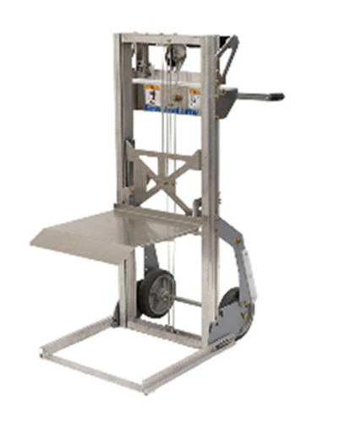
Solutions To Address Difficulty Lifting
Reallocate lifting duties if marginal
Assist when moving objects/people, to reduce weight
Organize items in a way that reduces the need to move items
Place frequently used tools and supplies at or near waist height
Reduce weight by separating items into smaller groups
Use a compact material handling device to lift, push, pull
Use a lift cart to move/raise items

Slide 42
Reassignment to a Vacant Position
Can be a form of accommodation when there is no alternative effective solution in the original position
Temporary or permanent reassignment can be explored
ADA does not require employer to create a position; explore equivalent vacant positions for which individual is qualified
May require other forms of accommodation (e.g., telework, equipment, schedule modification)
Accommodation of last resort

Slide 43
JAN Long COVID Resources
Accommodation and Compliance: Long COVID
Accommodating Employees with COVID-19 or Long COVID
Long COVID and the Americans with Disabilities Act
Supporting Employees with Long COVID: A Guide for Employers
Accommodation Solutions for Executive Functioning Deficits

Slide 44
Use the Q&A Option to Submit

Slide 45
Thank you for attending! “What You Should Know About the Impact of Long COVID in the Workplace”
Thank you, collaborators!
Terri Rhodes, Chief Executive Officer, Disability Management Employer Coalition (DMEC)
Bryon Bass, Senior Vice President, Workforce Absence & Disability Practice Leader, Sedgwick
Susanne Bruyere, Co-Director & Co-Principal Director, Employer Assistance & Resource Network on Disability Inclusion (EARN)

Slide 46
Thank you for attending “What You Should Know About the Impact of Long COVID in the Workplace”
Next JAN Webcast: “Accommodation Solutions for Neurodivergent Workers” Thursday, April 13 @ 2:00 p.m. ET
JAN Training Events & Resources AskJAN.org/Events/Trainings.cfm

Slide 47
How do I claim the HR CEU?
Don’t close the JAN webcast browser
Complete the webcast evaluation in new window
Click on “View your certificate of completion.”
Or go to AskJAN.org/EvaluationReg.cfm

Slide 48
Contact JAN for More Information
Visit
AskJAN.org
Call
800.526.7234
877.781.9403 (TTY)
Live Chat
@ AskJAN.org
Email
JAN@AskJAN.org
Social Media
Facebook – Job Accommodation Network Twitter – @JANatJAN

