Slide 1
ATIA 2023 Conference
January 25 to 27, 2024
Orlando, FL + Virtual

Slide 2
Accommodating Educational Professionals:
Meeting Workplace Needs with AT
TWA-05
Julie Davis
Teresa Goddard
Lisa Mathess
Job Accommodation Network
AskJAN.org
1-800-526-7234

Slide 3
Speaker Disclosure
Julie Davis has financial relationships to disclose. [employment salary]
Teresa Goddard has financial and non-financial relationships to disclose. [employment salary & ATIA strand advisor]
Lisa Mathess has financial relationships to disclose. [employment salary]

Slide 4
Learning Objectives
Discuss five real-life workplace accommodations that have been implemented to harness the potential of employees with disabilities who work in educational settings.
Identify three common job-related issues for employees with disabilities in educational settings.
Participate in a guided demonstration of JAN’s A to Z Lists at https://AskJAN.org/A-to-Z.cfm and use this resource to identify three accommodation solutions.

Slide 5
Session Evaluation and CEUs
Session Feedback Evaluation
Your Feedback is very important to us. Please be sure to complete session evaluations through the ATIA mobile app.
CEUs
ATIA 2024 education sessions are reviewed for ACVREP, AOTA, ASHA, CRC and IACET CE eligibility. Not all sessions are approved for each specialty CEU. Please see each session description for CEU availability.
Full information: atia.org/atia-2024-orlando-ceus

Slide 6

Ask JAN! We Can Help
Job Accommodation Network (JAN) was established in 1983
National, free consulting service
A service of the U.S. Department
of Labor’s Office of Disability Employment Policy/ODEP
Practical guidance and technical assistance for employers, people
with disabilities, and others on:
Accommodation process strategies
Job accommodation solutions
Title I of the ADA and related legislation
Self-employment and entrepreneurship options for people with disabilities

Slide 7




Typical Issues — Education Settings
Scheduling constraints
Student needs
Policies, procedures,
& regulations
Availability of resources
Parent expectations
Administrator attitudes

Slide 8



What are typical accommodation needs?
Schedule modifications
Restroom needs
Emergency preparedness
Work-related aides
Communication
Accessing information/systems

Slide 9

Situations & Solutions

Slide 10
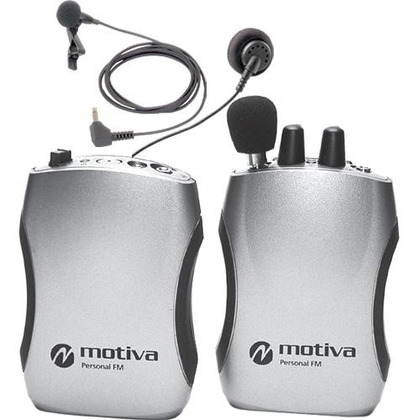
Auditory Processing Disorder
JAN Study Example
A university employee with auditory processing disorder requested a high-end FM assistive listening system, which would cost the employer $2,800. The employer contacted JAN looking for cheaper alternatives.

Slide 11
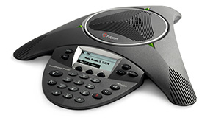
Auditory Processing Disorder — Solution
The employer contacted their state AT project and borrowed a Polycom phone that they eventually purchased.
Cost: $100
Benefit: Retained an experienced employee.

Slide 12

Vision Impairment
JAN Study Example
An educational social worker with a vision impairment was having difficulty keeping up with case documentation due to screen reader issues and possible need for scripting. The administration wanted the employee to be fully independent.
The employee did have a qualified reader/scribe, but they weren’t always available.

Slide 13

Vision impairment — Solution
During their JAN consultation, the employer learned about assistive technology, specifically the Aira.io desktop app, which provides sighted visual aid over a computer VPN. They also discussed the Aira.io app, which is used over a smartphone.
Scripting was discussed, and a referral to their state commission for the blind was provided.

Slide 14
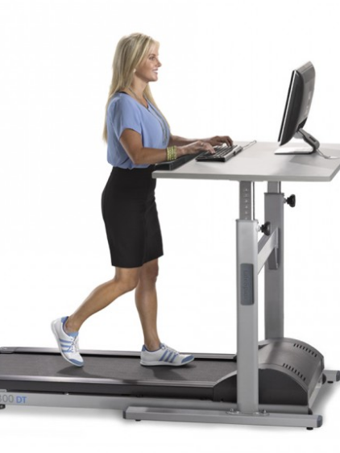
Arthritis
JAN Study Example
An educator with arthritis was having trouble accessing their workstation. The employee requested a treadmill desk as an accommodation. The employer contacted JAN regarding their obligation to provide the requested accommodation, as this would be thousands of dollars.

Slide 15
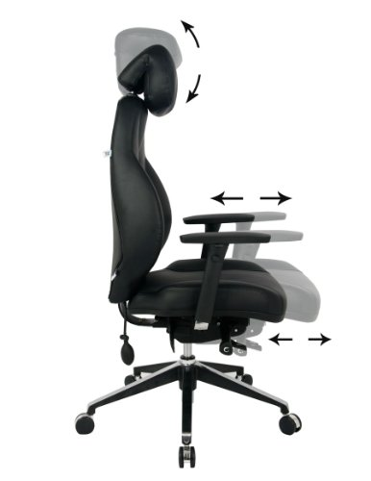
Arthritis — Solution
The employer purchased an adjustable desk and chair.
Cost: $3,000
Benefit: “The employee is comfortable, feels supported, and medical issues aren't aggravated to the point they can't work.”

Slide 16
Dyslexia — Situation & Solution
JAN Study Example
A university employee with dyslexia requested their supervisor proofread all their emails and reports. The employer didn’t think this was practical and called JAN seeking other ideas.
Accommodation
After discussing software options for writing, reporting, and documenting with a JAN consultant, the employer implemented software they already owned.

Slide 17
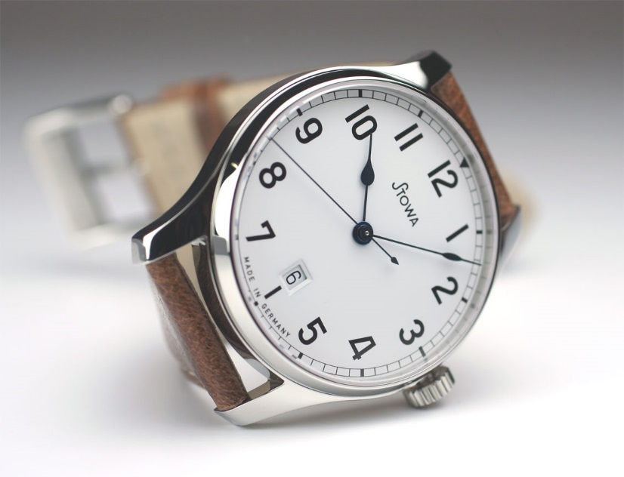

Attention Deficit/Hyperactivity Disorder
JAN Study Example
A sixth-grade teacher with ADHD had difficulty finishing paperwork, staying on task, and staying on topic during lessons. They also had difficulty getting to work on time and generally managing time appropriately.

Slide 18

Attention Deficit/Hyperactivity Disorder — Solution
The teacher received a computer with calendar software that included time management, scheduling, and planning features. They also utilized a color-coded portable filing system to organize the teaching materials, memos, and reminders. Peer support was also provided.
Cost: $40
Benefit: Retained a valued employee.

Slide 19
Emergency Alert
JAN Study Example
A school administrator contacted JAN seeking guidance regarding a teacher who was hard of hearing. The teacher could hear the initial fire alarm and evacuate the class safely but couldn’t hear the announcements indicating it was clear to return inside.
They tried a buddy system, but distance made that hard. A trial period of text alerts, visual cues, and student cues were attempted, but nothing was reliable. The administration wanted the teacher to be alerted to the official announcement in real time.

Slide 20
Emergency Alert — Solution
JAN discussed creation of a login for Streamer.Center that the teacher and the office making the announcement could both log into. That way the person making the announcement could be transcribed as they verbally made the announcement, and the teacher could visually see the announcement in real time. This approach also enabled other teachers with concerns the ability to log in and see the captioning stream.
All parties preferred this option as it seemed more effective, safe, and reliable in the event of a true emergency. This also enabled independence for the teacher.

Slide 21
Diabetes
JAN Study Example
An employee at a college was having difficulty complying with a dress code rule that required employees to wear shirts tucked in. The employee needed to leave their shirt partially or fully untucked because of the placement of their insulin pump. The employer did not want to modify the dress code policy to allow untucked shirts. They expressed concerns about the employee's safety, as they sometimes had to work around machinery.

Slide 22
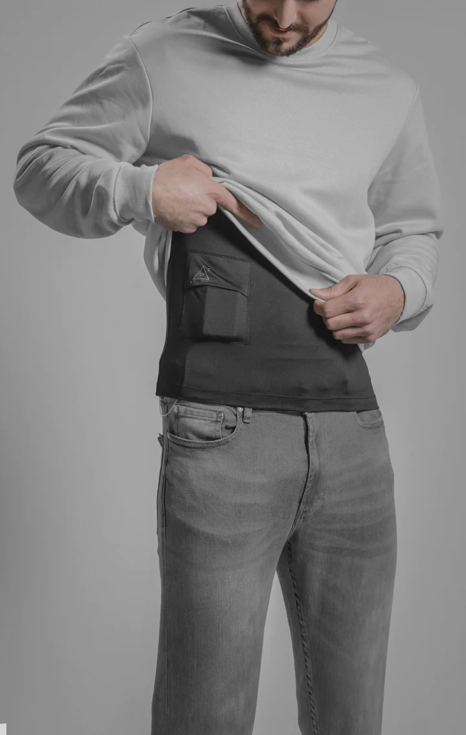
Diabetes — Solution
A JAN consultant provided information on safety and the ADA as well as information on clothing designed for use with insulin pumps. The employer provided a one-arm/waist harness for the pump.
Cost: Less than $20
Benefit: Both the employer's and the employee's needs were met.

Slide 23

Assistive Device
JAN Study Example
An employee at a community college asked for a Bluetooth streamer to assist with access to meetings and trainings and to enhance day-to-day conversation. The employer wanted to purchase it but also wanted to have some rules for how to keep it from being damaged.

Slide 24
Assistive Device — Solution
After learning from a JAN consultant about ownership and control of products, the employer’s HR department made the decision to provide an assistive listening device.
Cost: Less than $1,000
Benefit: The employer reported that the accommodation was extremely effective and resulted in improved worker productivity, morale, and safety, as well as allowed them to save on workers’ compensation costs while retaining a qualified employee.

Slide 25

Hard of Hearing
JAN Study Example
A teacher with a hearing impairment recently switched jobs and was having difficulty because there were no inclusion aides present to assist as there had been in their previous job.

Slide 26

Hard of Hearing — Solution
The accommodation solution included buying an auditory sciences system,
which was effective.
Cost: $3,000
Benefit: The employee can work more effectively and better communicate.

Slide 27
Asthma & Chemical Sensitivity
JAN Study Example
A technology assistant working for a school district had both asthma and chemical sensitivity. As a result, they were sensitive to fragrances and wanted the district to reduce the employee’s exposure to fragrances, particularly when they were working in classrooms.
The school district was willing to consider accommodations but had concerns about the feasibility of guaranteeing a fragrance-free environment. They were also concerned about the effectiveness of a fragrance-free policy.

Slide 28


Asthma & Chemical Sensitivity — Solution
The employer made the following accommodations: purchase of a fan, allowing/providing a mask, and posting a notice.
Cost: $200
Benefit: The employer stated, “Yes, this has worked, and there have been no more complaints.”

Slide 29
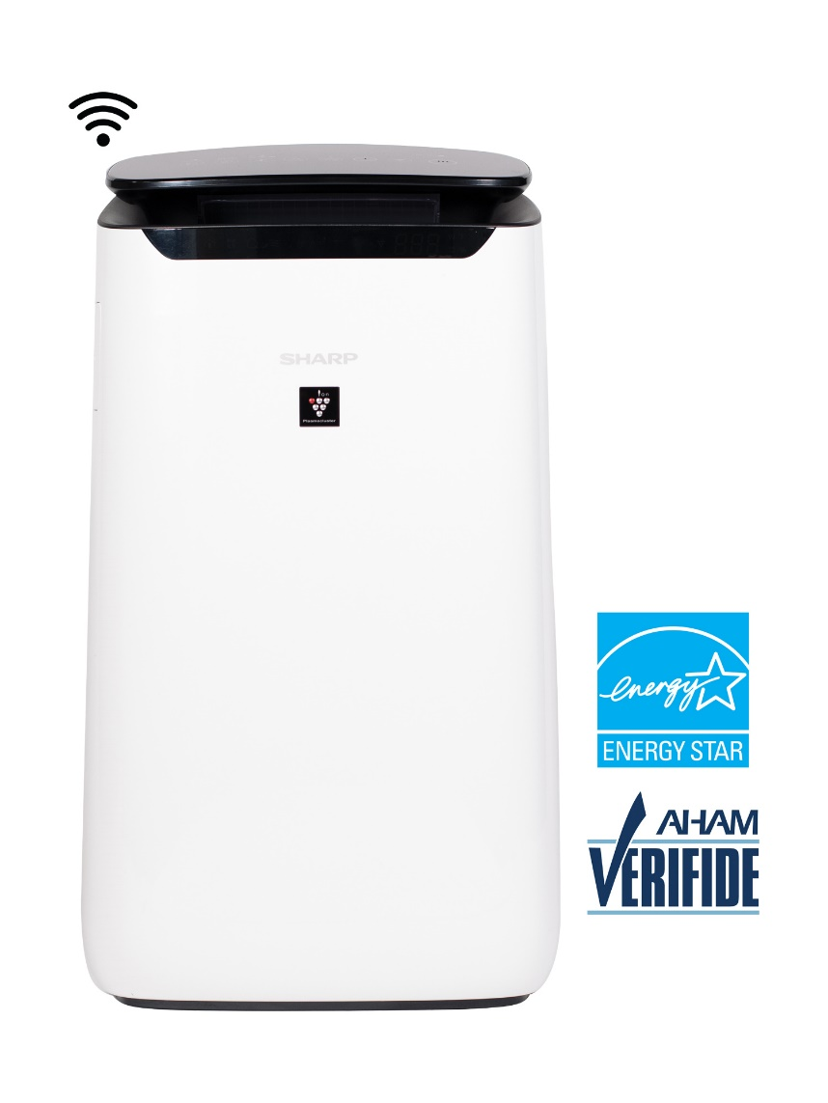
Additional AT Option
JAN vendor listing:
Air Purifiers for Larger Spaces

Slide 30
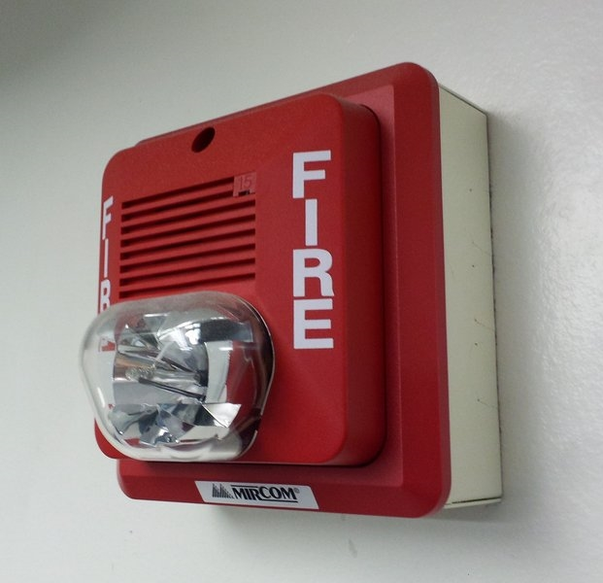
Deaf-Blind
JAN Study Example
A librarian who was deaf-blind was unable to respond to fire drills at the library. Their employer called JAN seeking alternative solutions.

Slide 31
Deaf-Blind — Solution
The library installed additional strobe lights and is in the process of implementing a vibrating alerting system as an additional safety measure.
Cost: One-time cost of $500
Benefit: Peace of mind, “staff member who is deaf and has low vision can now see the fire alarm system and is self-reliant in the case of an emergency.”
Direct Benefit: Allowed the library to retain a qualified employee
Indirect Benefits: Improved morale, workplace safety, and interactions
with co-workers.

Slide 32
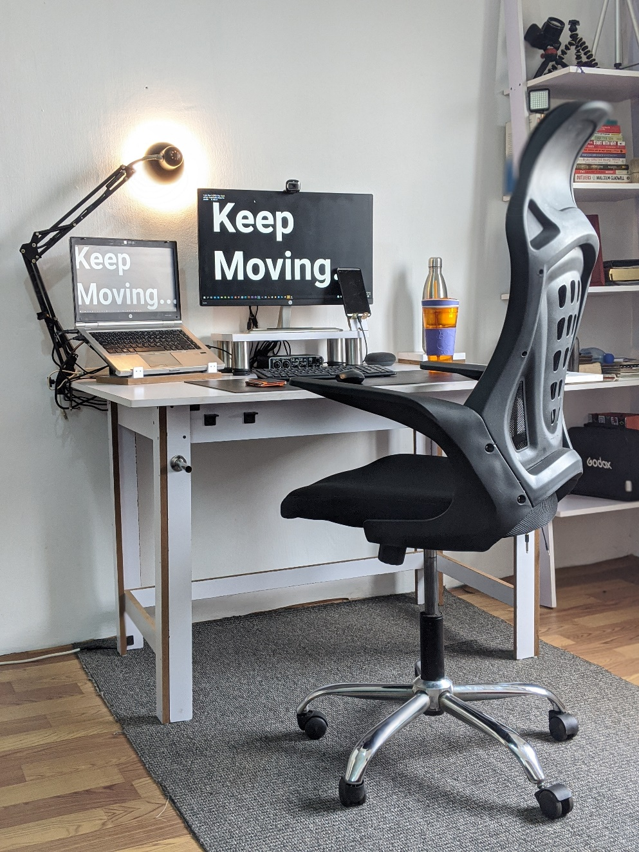
Back Impairment
JAN Study Example
A university worker had back surgery. Complications included loss of functionality in one hand and damage to his larynx resulting in difficulty speaking. The employer contacted JAN for ideas to help the employee with workstation access and communication.

Slide 33
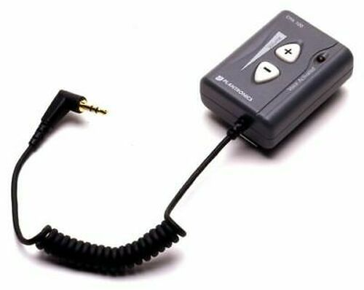

Back Impairment — Solution
The employer bought a posture-enhancing keyboard holder, voice amplifier, Dragon software, and an ergonomic chair.
Cost: One-time cost $5,000
Benefit: By making these accommodations, the employer complied with the ADA and made their employee and manager happy.

Slide 34
Fibromyalgia, Depression, Migraines, and Chemical sensitivity
JAN Study Example
An educational administrator at a junior college had fibromyalgia, depression, migraines, and chemical sensitivity. This employee requested a number of accommodations, including reducing hours, moving their work area, time off, and minimizing job stress and performance expectations.
The employer contacted JAN for guidance on responding to these requests.

Slide 35

Fibromyalgia, Depression, Migraines, and Chemical sensitivity — Solution
The employee was accommodated with alternative lighting to aid in migraines, changes in her work schedule, including a flexible start and end time depending on symptoms, and was granted telework on an as-needed basis.

Slide 36

Additional Accommodation Solution Resources
JAN resources:
Workin’ 9 to 5 – Not The Only Way to Make a Living
Accommodation and Compliance: Telework
Dealing with Stress in the Workplace
Dealing with Stress in the Workplace, Part 2
Full Spectrum or Natural Lighting Products (Vendor Listing)

Slide 37

JAN Website Tour

Slide 38

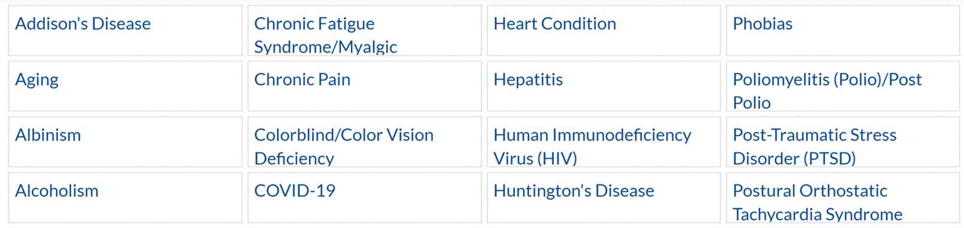
AskJAN.org A to Z
A to Z of Disabilities and Accommodations

Slide 39
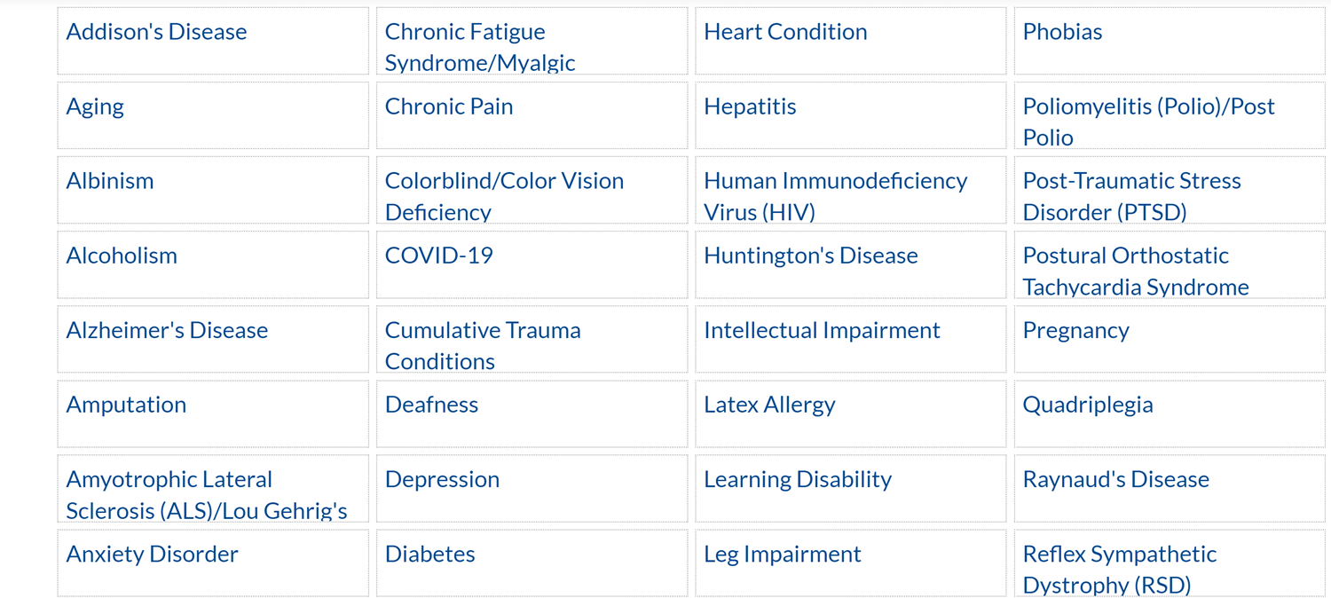
AskJAN.org by Disability

Slide 40
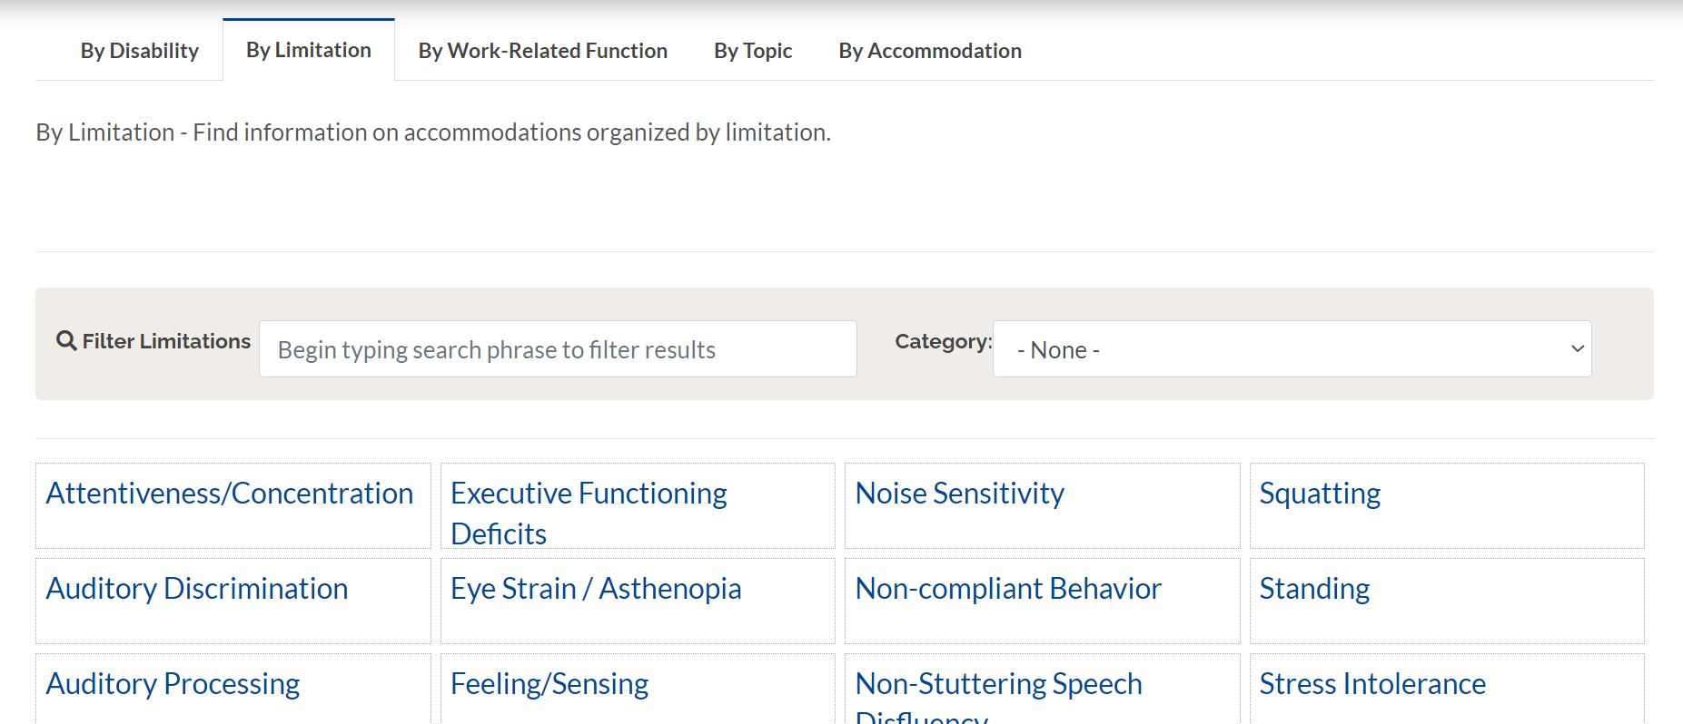
AskJAN.org by Limitation

Slide 41
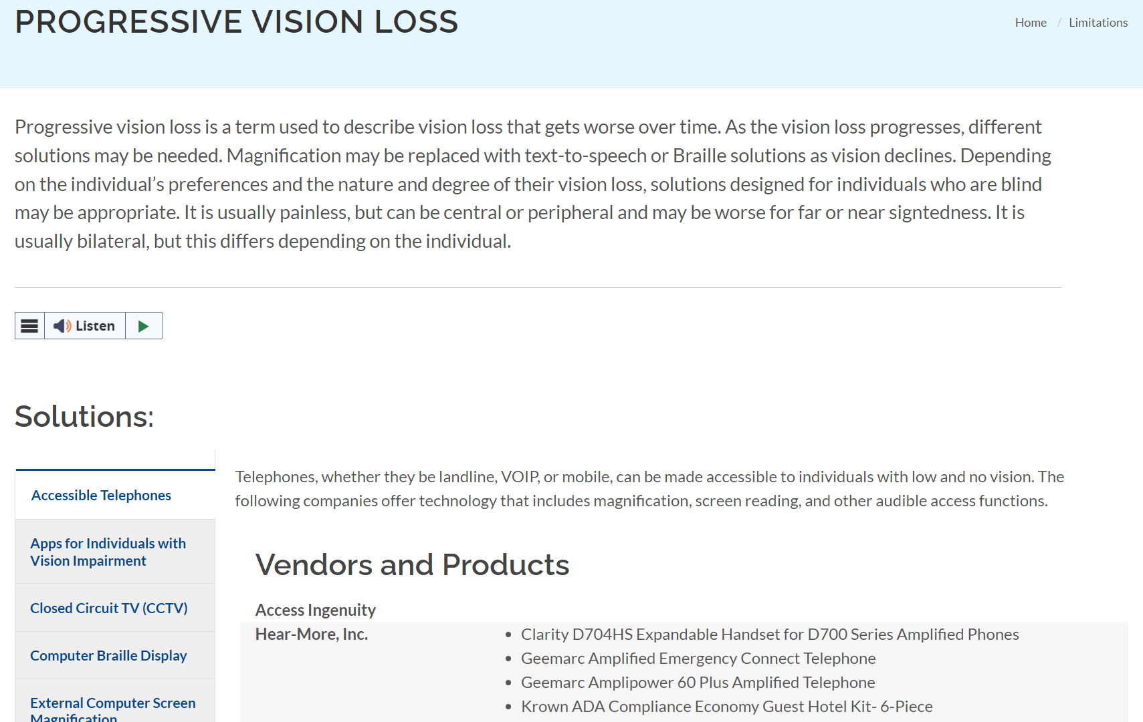
AskJAN.org by Limitation:
Progressive Vision Loss

Slide 42
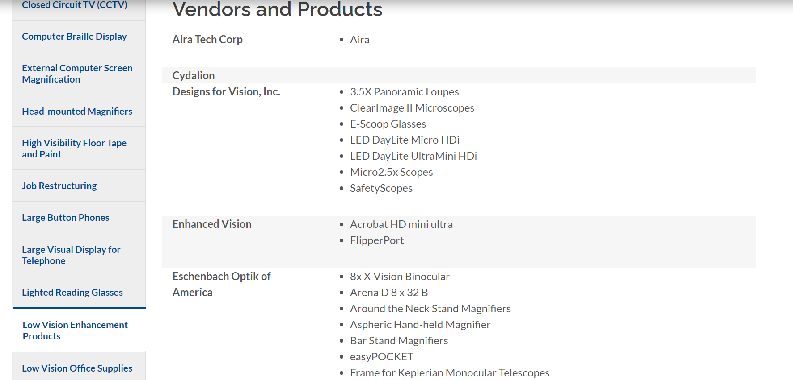
Progressive Vision Loss:
Low Vision Enhancing Products

Slide 43
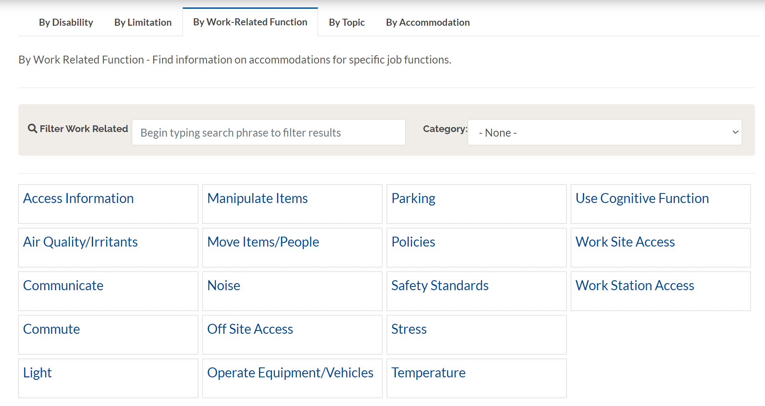
AskJAN.org by Work-Related Function

Slide 44
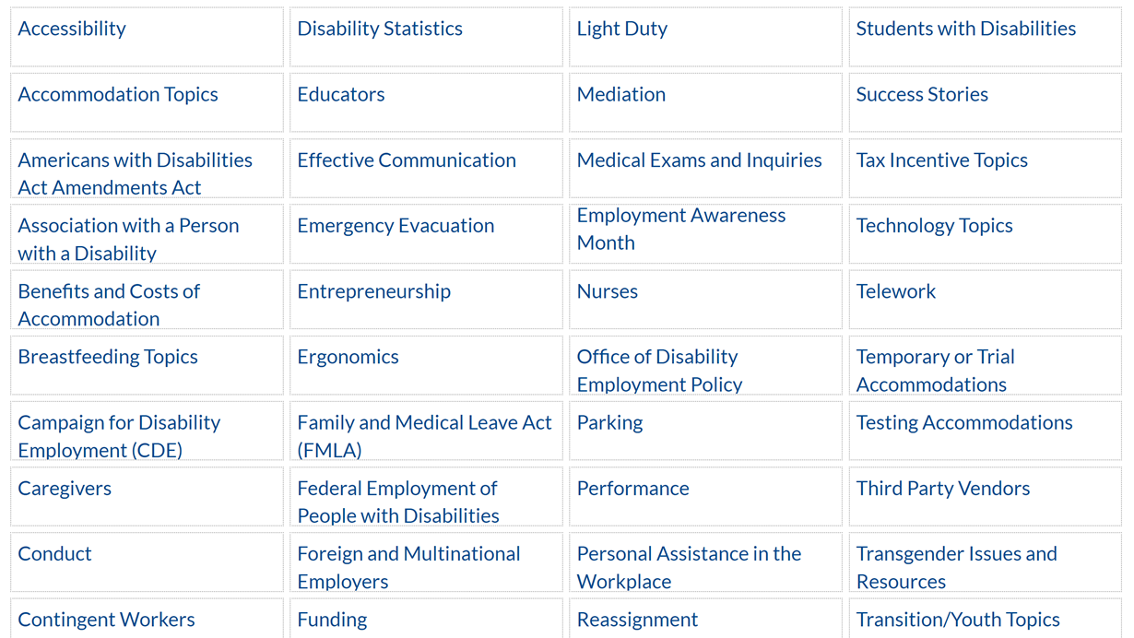
AskJAN.org by Topic

Slide 45
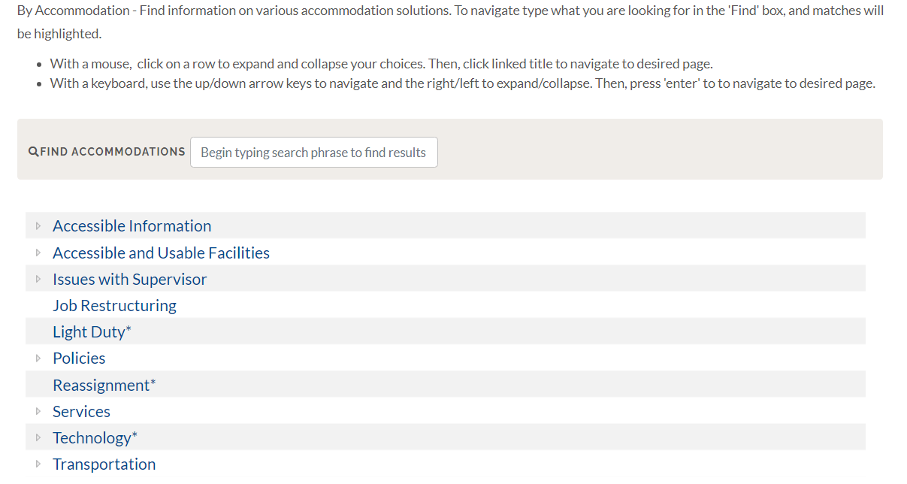
AskJAN.org by Accommodation

Slide 46
Questions
Questions

Slide 47




Ask JAN! We can help.
AskJAN.org
800.526.7234
Live Chat @ AskJAN.org
Email JAN@AskJAN.org

Slide 48

JAN Resources
Accommodations for Educators
who are Deaf or Hard of Hearing
Teleconference Accessibility and Hearing-Keeping Deaf and Hard of Hearing Employees in the Loop
Occupation and Industry Series: Accommodating Educators with Disabilities
It’s Back to School Time – Accommodating Educators with Disabilities
Choosing Among Options for Computer Users with Low Vision
The Interactive Process and
Service Providers
How to Request an Accommodation: Accommodation Form Letter
Your Accommodation Request Was Denied. What Now?

Slide 49
Thank You
Thank You

